Slide 1
Final Project
Loan Data
Kayla Benedetti, Erika Larsen, Rosie Short

Slide 2
Overview
Loans
Compared Loan Data from 2007 through June 2019
Emphasized before and after 2008 Financial Crisis
Loan amount vs. Debt
Factors of loans
Regression Prediction
Tableau Dashboard

Slide 3
Underwriting Break Down
DTI - Debt to Income Ratio
Employment Length
Gaps in employment
Current employer less than 2 year
# of Delinquencies - past 2 year
Late payments on credit accounts
% of Revolving credit debt
Credit accounts without a fixed monthly payment
Example: Credit Cards

Slide 4
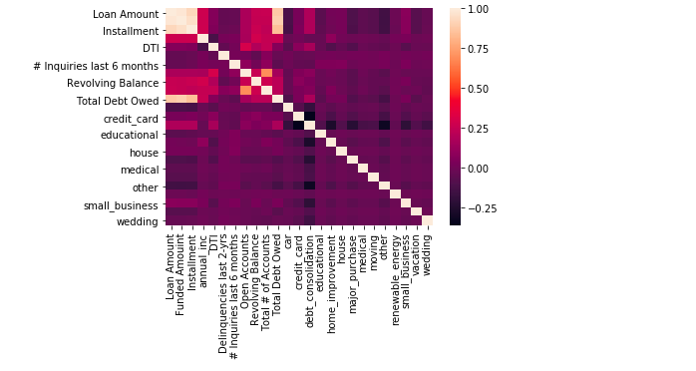
Regression: Heatmap

Slide 5
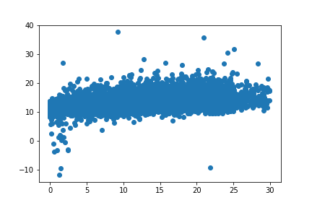
Regression: DTI to Loan Amount

Slide 6
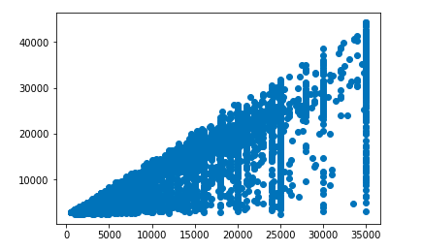
Regression: Total debt owed to Loan Amount

Slide 7
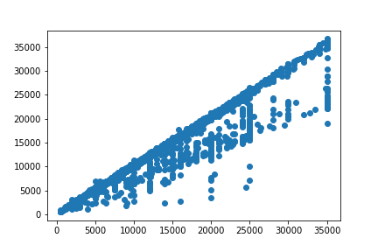
Regression: All factors to Loan Amount

Slide 8
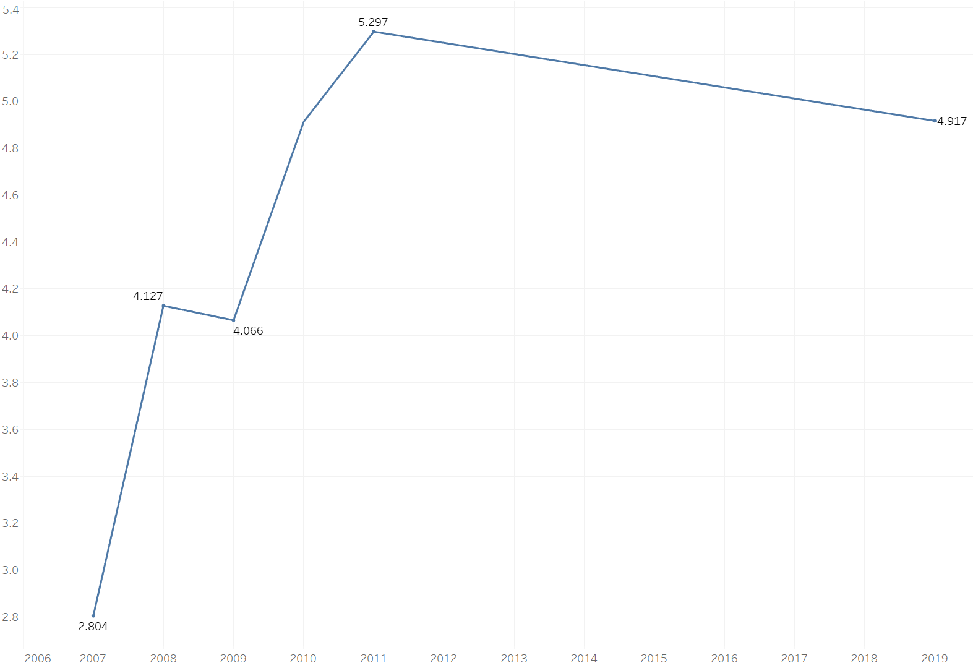
Employment Length
Avg Employment Length per Applicant
Loan Approval Date

Slide 9
Tableau Dashboard
Load Data Dashboard

Slide 10
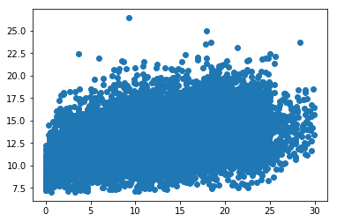
DTI Model
Variables Used : Number Inquiries last 6 months (+), Revolving Balance/Revolving % (+), Total Debt Owed (+), Total # of Accounts (+) , Annual Income (-)
Training Score: 0.189 Testing Score: 0.200

Slide 11
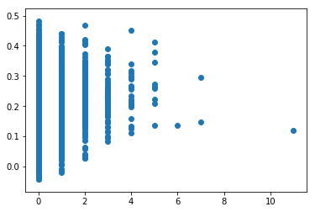
Delinquency Model (2 Years)
Variables Used: Interest Rate (+), Annual Income (-), Total Number of Accounts (+), Home Ownership-Mortgage (-)
Training Score = 0.029 Testing Score = 0.033

Slide 12
Conclusion and Questions

Slide 13
Resources
“Personal Loans Borrow up to $40,000 and Get a Low, Fixed Rate.” LendingClub, www.lendingclub.com/info/download-data.action
https://github.com/erikaplarsen/Final_Project

